Slide 1
Recorder Hero!
6.111 Final Project
Paul Hemberger, Andres Romero

Slide 2

Source: http://www.vgcats.com/comics/?strip_id=230

Slide 3

Source:
http://www.hightech-edge.com/guitar-hero-3-legends-of-rock-xbox-games/1468/

Slide 4
SCORE: 54013
PITCH: C
C
B
A
G
F
E
D
C

Slide 5
Technical Overview
FFT
Game State Machine
Video
Musical Score

Slide 6
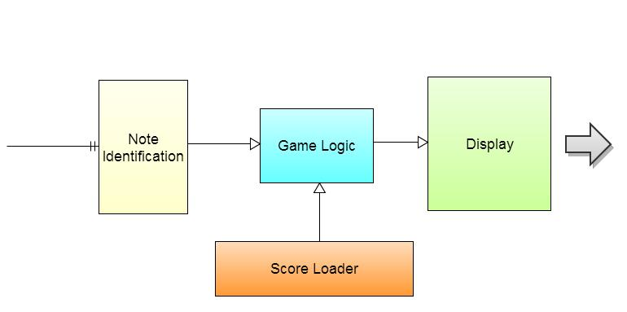
Overall Block Diagram

Slide 7
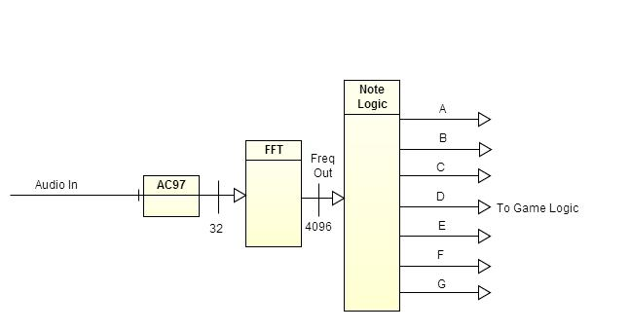
Note Identification

Slide 8
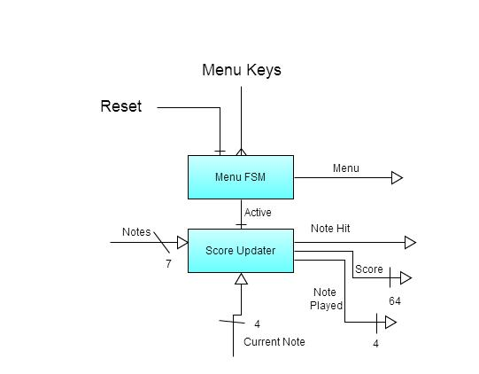
Game State Machine

Slide 9
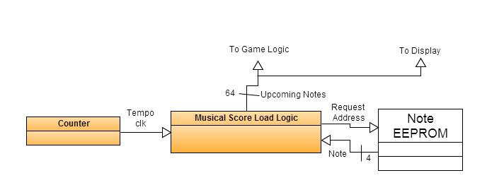
Score Loader

Slide 10
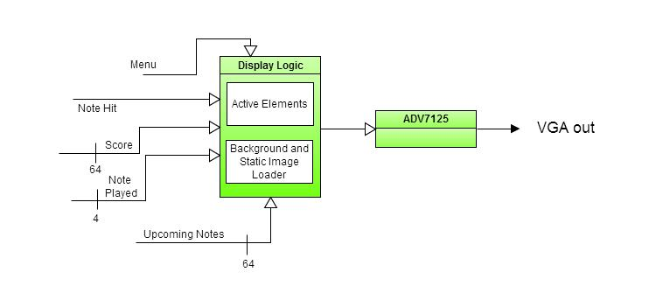
Display

Slide 11
Timeline
Week | Paul Hemberger | Andres Romero
11/12 | Game Display | FFT
11/19 | Score Loading | Full Note Identification
11/26 | Menu Display | Game Logic
12/3 | Polish & Integration

